Slide 1


Final Presentation Supervisor: Ricky Zheng Master of Data Science
AYAN Krishna Paul
47697296

Slide 2
Project/objective
Project title | Objective/ goal | Description of the problem | Why is it Important for the Company?
Comprehensive Data Quality Enhancement and Testing Across Models. | To strengthen data quality, integrity, and reliability across multiple models by implementing primary key validations, tolerance thresholds, extensive unit testing, and automated data quality checks. | From inconsistent data mappings and missing primary keys to incorrect internal area values, data issues across various models impacted the accuracy of analytics and reporting. The lack of standardized data testing and validation led to inconsistencies, hindering reliable insights and operational efficiency. | High-quality, consistent data is foundational for trusted insights, property valuations, and operational effectiveness. By implementing structured testing, automated checks, and data quality standards, this project enables accurate decision-making, strengthens data reliability, and reinforces the company’s reputation as a provider of trusted property data solutions.

Slide 3

Methodology/Approach
Overview of the Methodology/Approach Used
Data Validation and Quality Checks: Implemented tolerance thresholds, primary key validations, and data mapping verification to enhance data integrity across models.
Unit and Integration Testing: Conducted thorough unit tests on each model, including primary key validation and data consistency checks, to identify and rectify issues early in the pipeline.
Automated Testing and Reporting: Established automated data quality checks and regular reporting to monitor data reliability and ensure continuous validation.
Tools, Technologies, and Frameworks Utilized
Database Tools: Snowflake, SQL for data validation and transformations.
Data Quality and Testing Frameworks: DBT (Data Build Tool) for automated testing and data transformations.
Collaboration and Documentation: Confluence for documentation, Jira for task tracking, and Slack for team communication.
Visualization and Reporting: Snowsight and custom dashboards for data quality reporting and visualization.

Slide 4


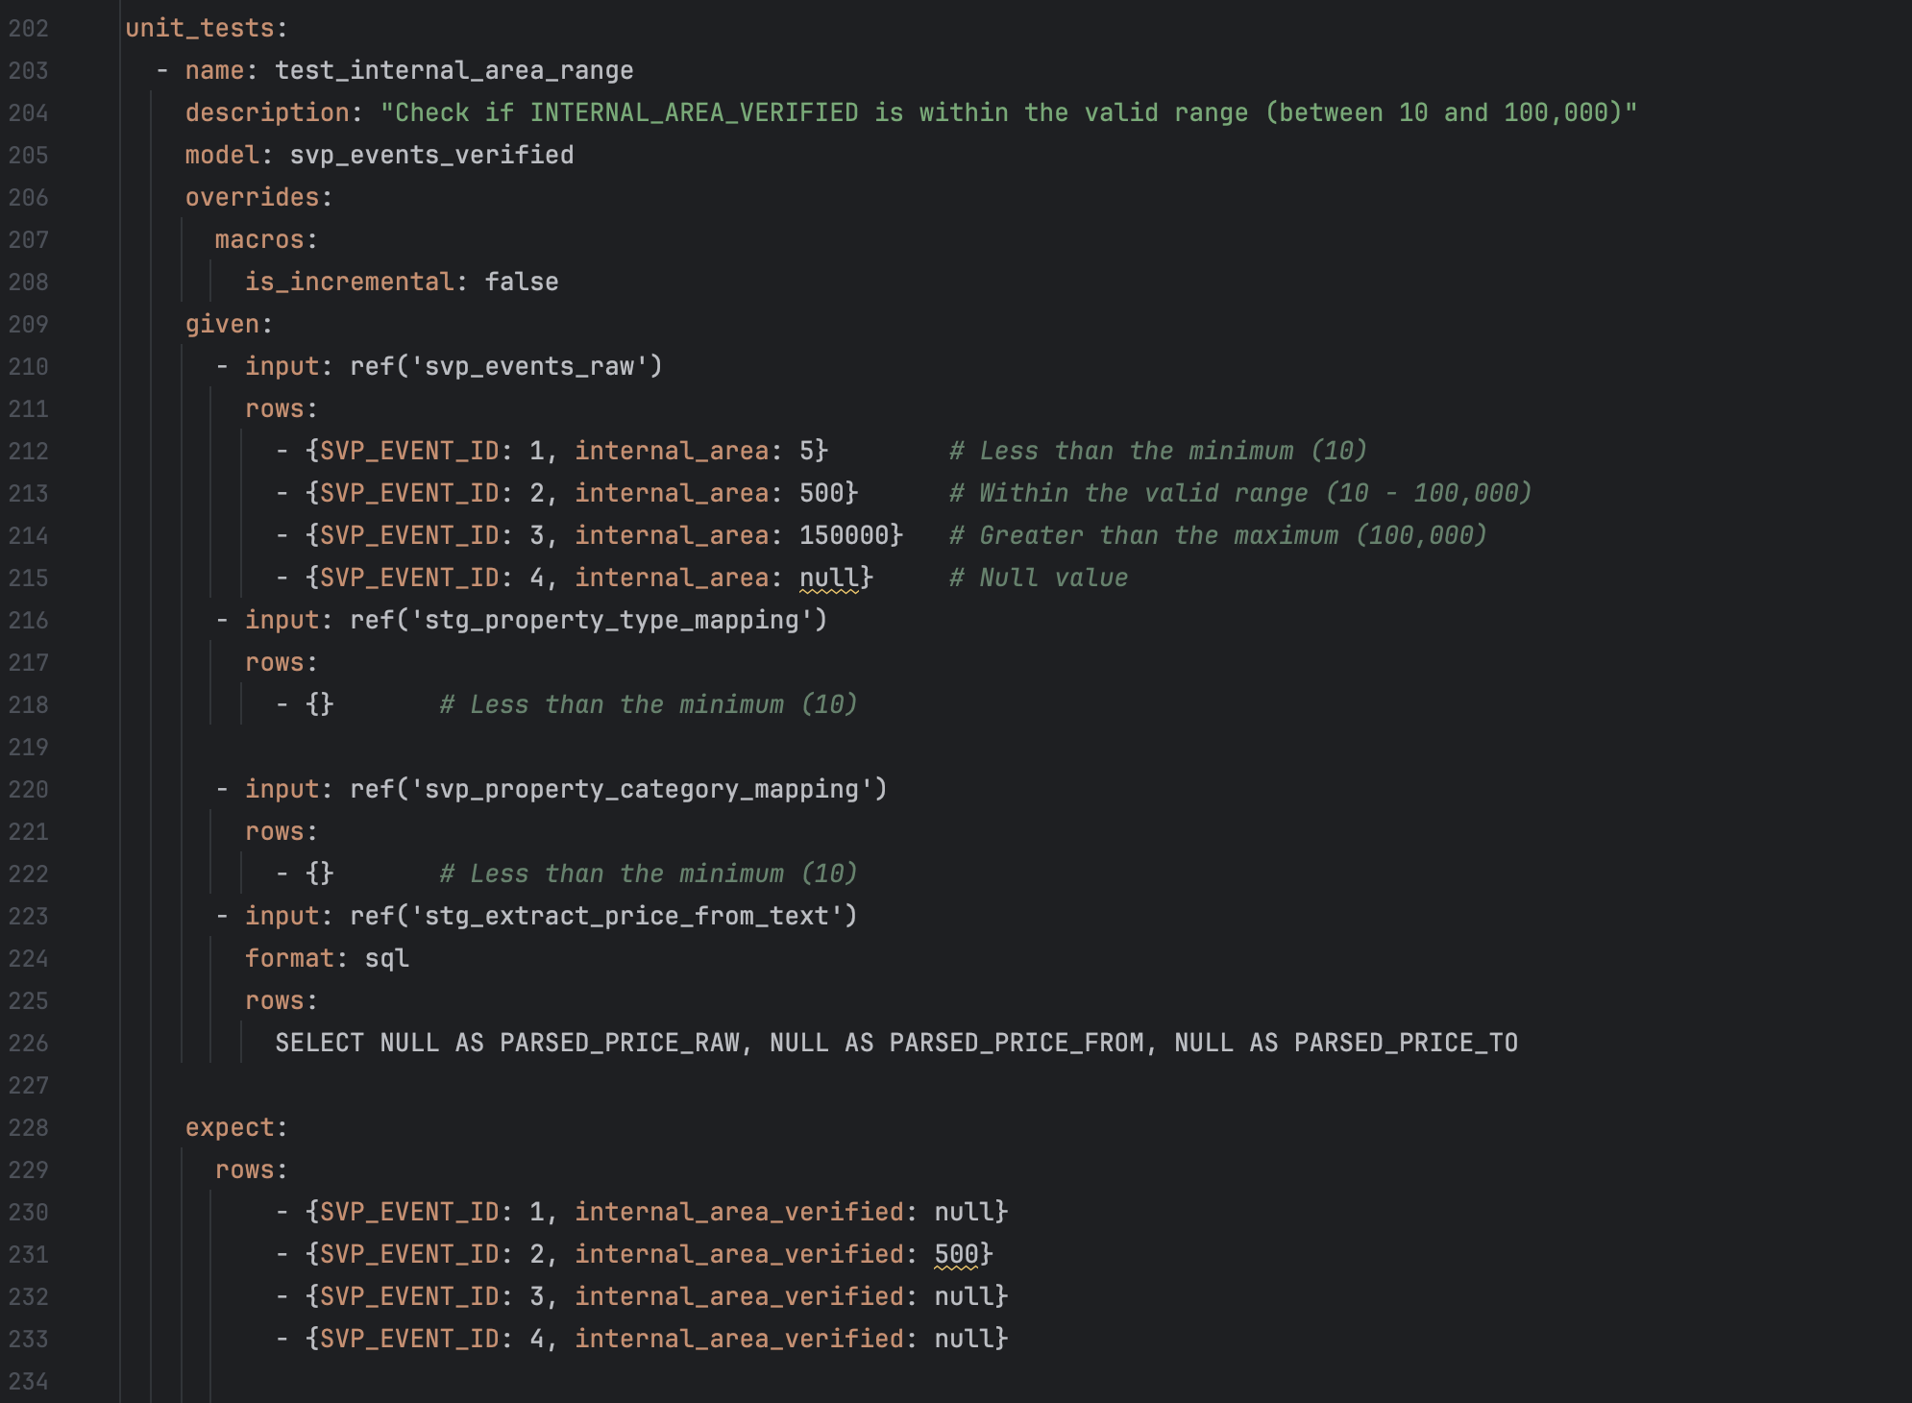
Project Implementation
High-Level Overview of Project Implementation
The project focused on enhancing data quality by establishing primary key validations, tolerance thresholds, and comprehensive data testing across multiple models. Each phase was implemented iteratively, allowing for adjustments based on findings and feedback.
Key Steps and Milestones Achieved
Initial Data Quality Assessment: Conducted a full audit across models to identify data inconsistencies, missing primary keys, and incorrect mappings.
Primary Key Validation and Data Cleaning: Implemented primary keys in models where missing, ensuring unique record identification and improved data integrity.
Tolerance Thresholds for Internal Areas: Set minimum and maximum limits for internal_area fields to filter out anomalous values, enhancing accuracy.
Automated Data Quality Testing: Established regular, automated testing routines using DBT to validate key metrics like data consistency and primary key uniqueness.
Ongoing Reporting and Monitoring: Created dashboards and scheduled reports to track data quality metrics, ensuring real-time monitoring and issue resolution.

Slide 5
Results and Achievements
Major Challenges Encountered
Data Inconsistencies: Initial challenges with missing primary keys, incorrect internal area values, and null fields (e.g., file_date) impacted data reliability.
Source Mapping Errors: Data mapping issues from certain sources required extensive investigation and correction.
How Challenges Were Addressed
Implemented primary key validation and tolerance thresholds, correcting outliers and standardizing data across models.
Collaborated with team members to trace mapping errors, ensuring accurate data flow from source to model.

Slide 6
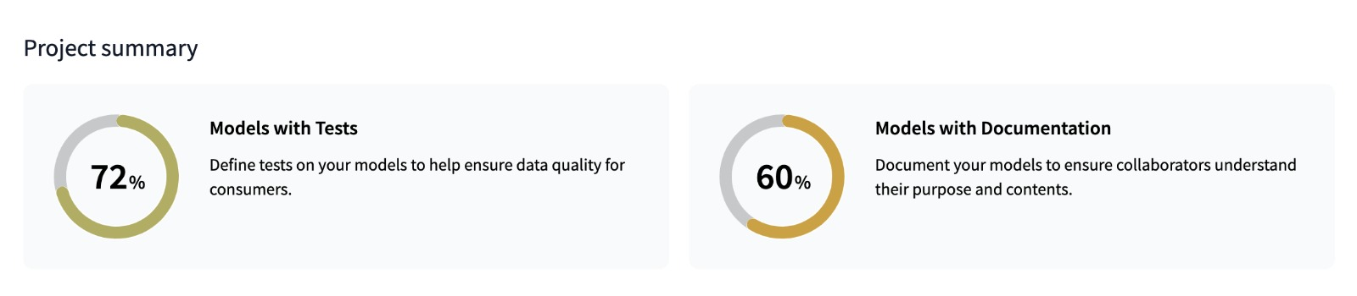
Results and Achievements
Key Outcomes and Achievements
Improved Test Coverage: Enhanced Domain's test coverage metrics from 69% to 72%, with further improvements expected once recent code updates are merged into the master branch.
Enhanced Data Quality: The implementation of tolerance thresholds and primary key validations reduced data inconsistencies, providing more reliable insights for stakeholders.
Automated Data Quality Checks: Established routine automated checks to continuously monitor data quality, reducing manual effort and improving data accuracy.
Metrics and Evidence Supporting Results
Test Coverage: Increased test coverage from 69% to 72%.
Data Accuracy: Significant decrease in null or incorrect values across models.
Continuous Monitoring: New automated dashboards and reports provide ongoing data quality metrics, ensuring real-time issue detection and resolution.

Slide 7
Conclusion
Lessons Learned
Gained hands-on experience in implementing data quality frameworks and troubleshooting complex data issues, enhancing technical skills in data validation, testing, and analysis.
Developed a deeper understanding of collaborative problem-solving, especially in managing data consistency across multiple sources and models.
Personal and Professional Growth
Improved critical thinking and adaptability by addressing real-world data challenges, which strengthened my analytical and troubleshooting abilities.
Enhanced communication and teamwork skills through regular collaboration with cross-functional teams, essential for effective data management in professional settings.
Potential Areas for Improvement
Increased automation of data validation tasks to further reduce manual efforts and increase efficiency.
Expanding the test coverage to achieve a broader scope and ensure even higher data reliability across all models.
Recommendations for the Company
Implement more detailed data documentation and source tracking to streamline troubleshooting and ensure clarity for all team members.
Encourage continuous training and cross-team knowledge-sharing sessions to foster a deeper understanding of data integrity and best practices across departments.

Slide 8
Thank You

